Slide 1
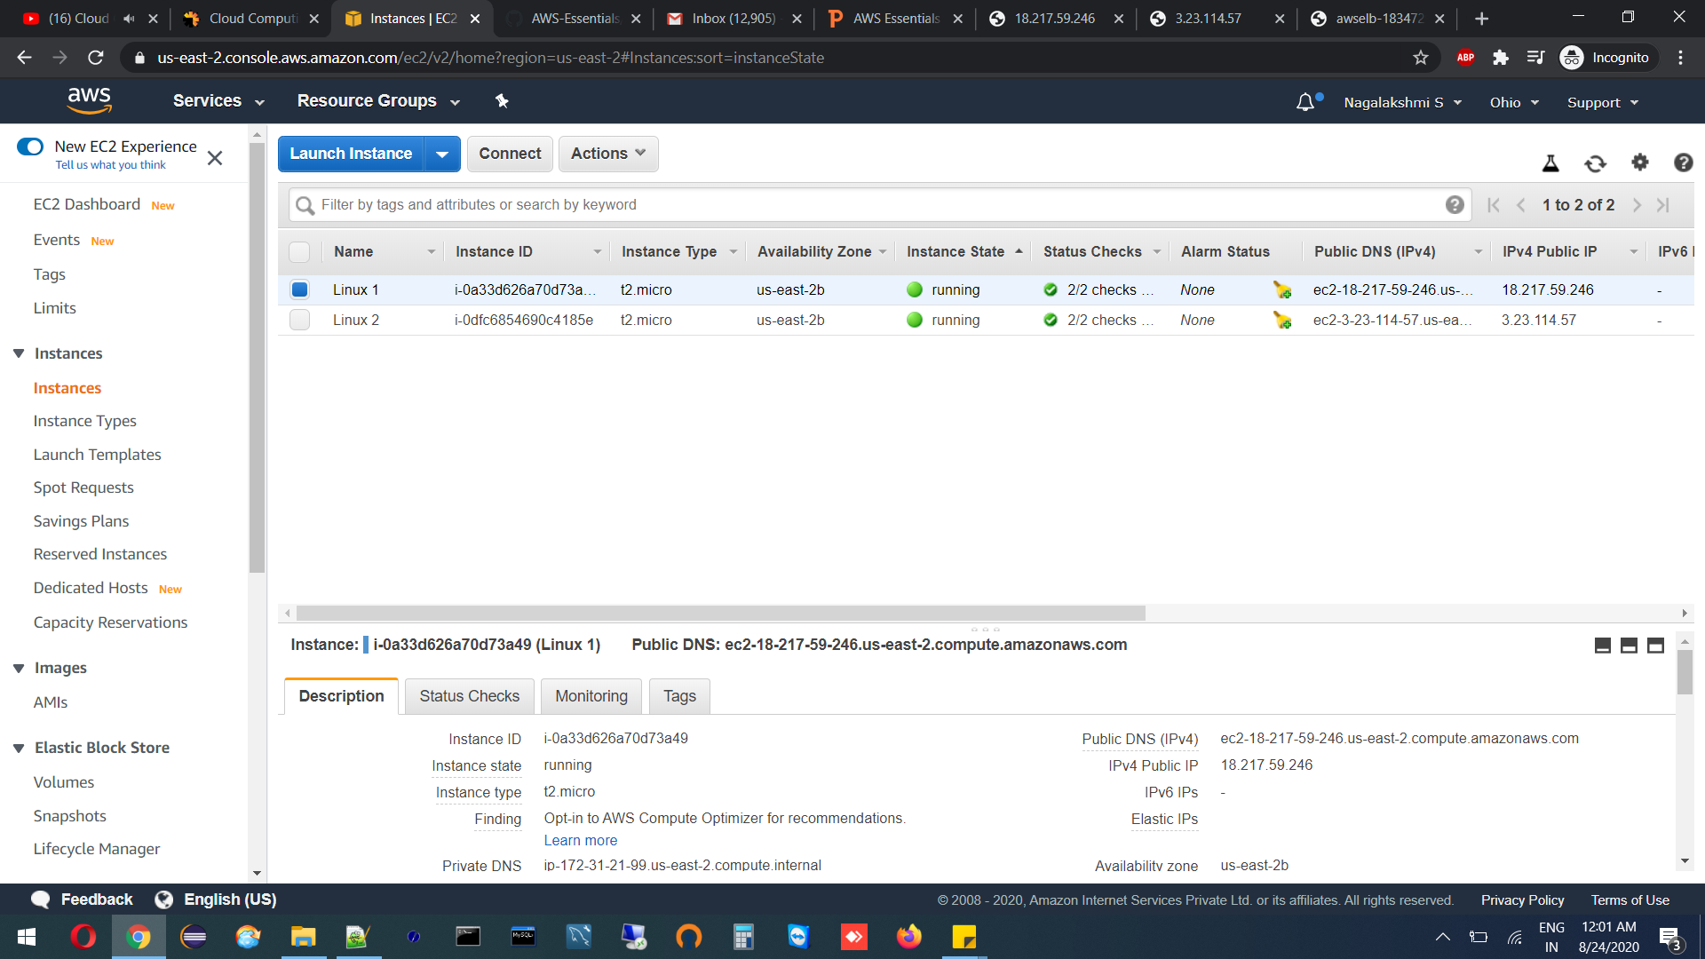
Creating Instance With Linux1

Slide 2

Creating Instance With Linux2

Slide 3
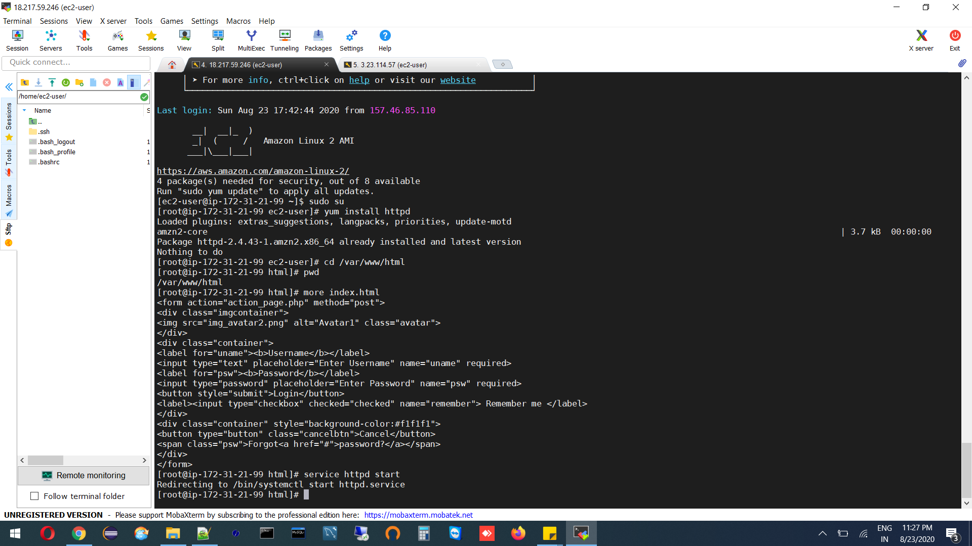
Launch Both Instances Using Mobaxterm

Slide 4
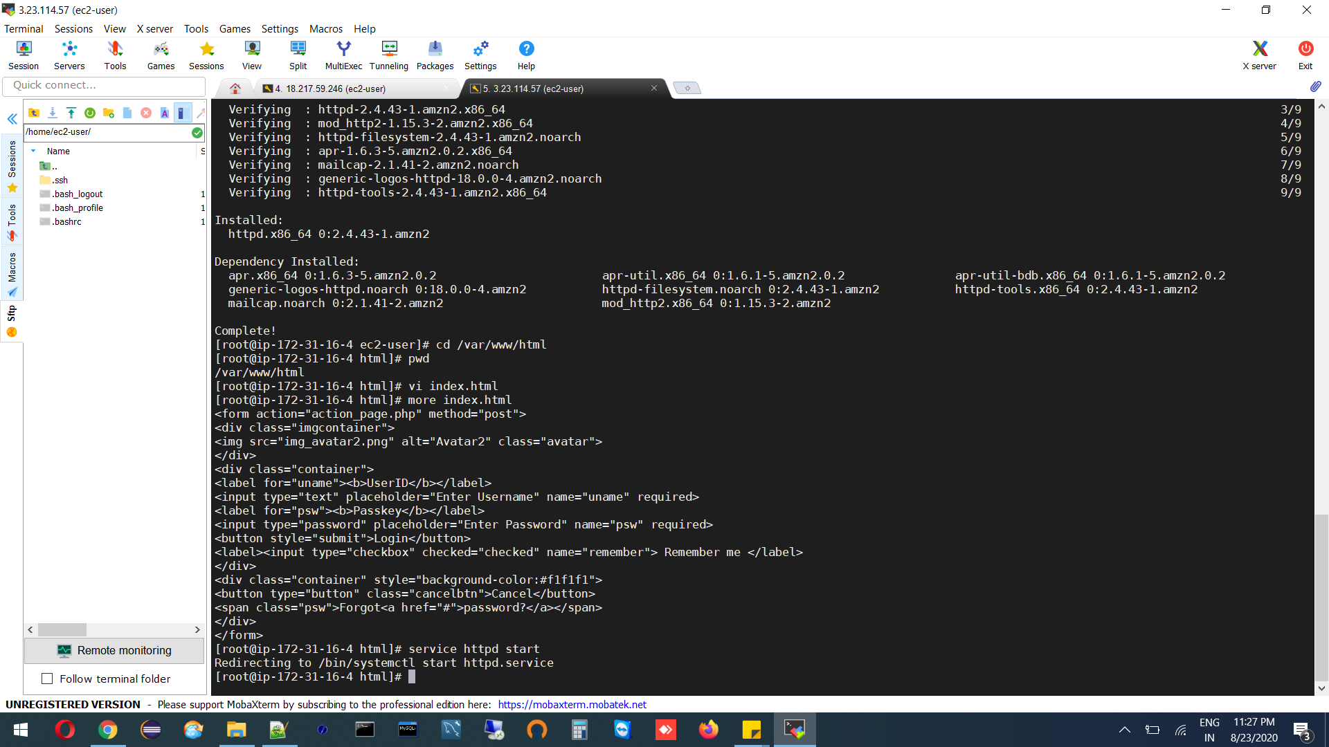

Slide 5
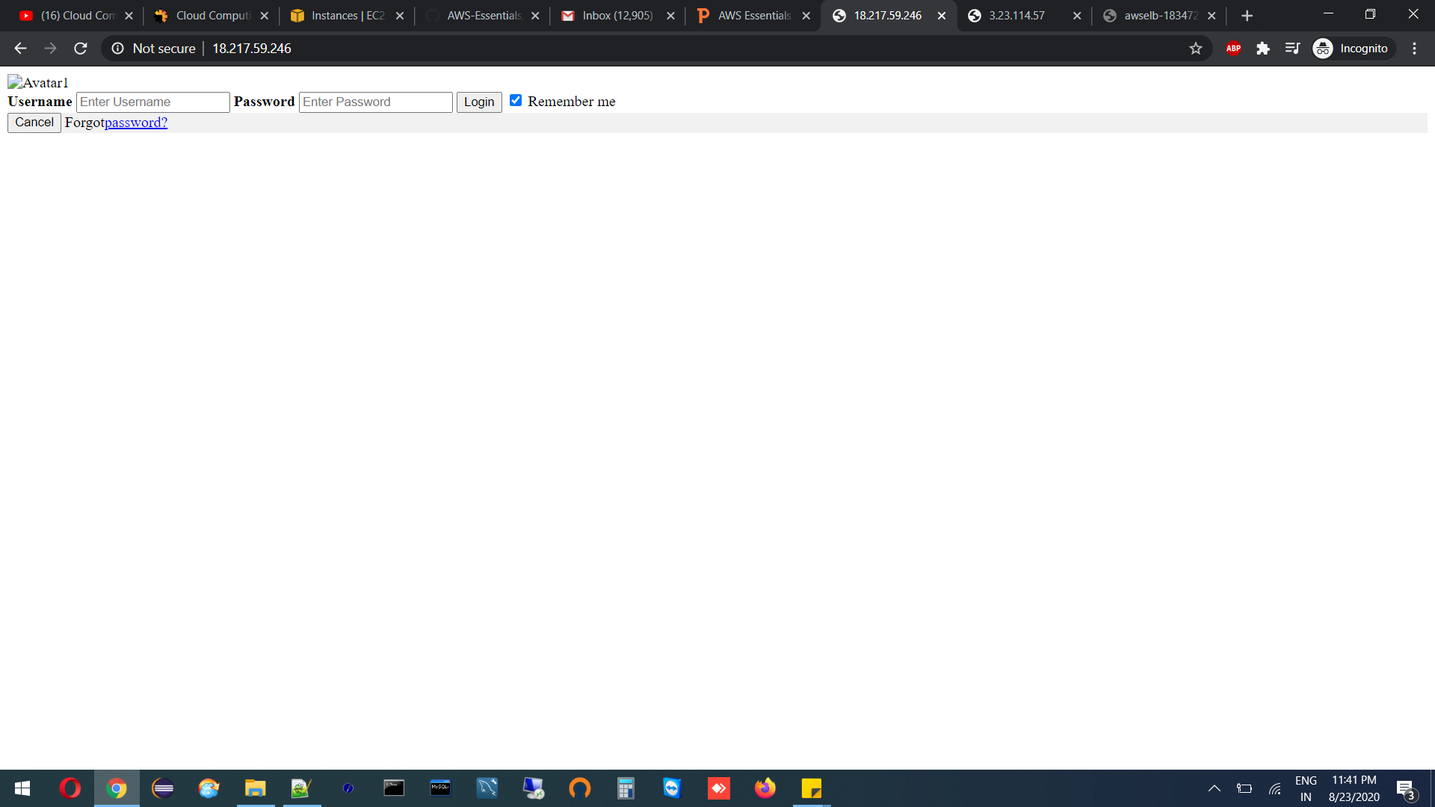
HTML Login Webpage On Both Servers

Slide 6
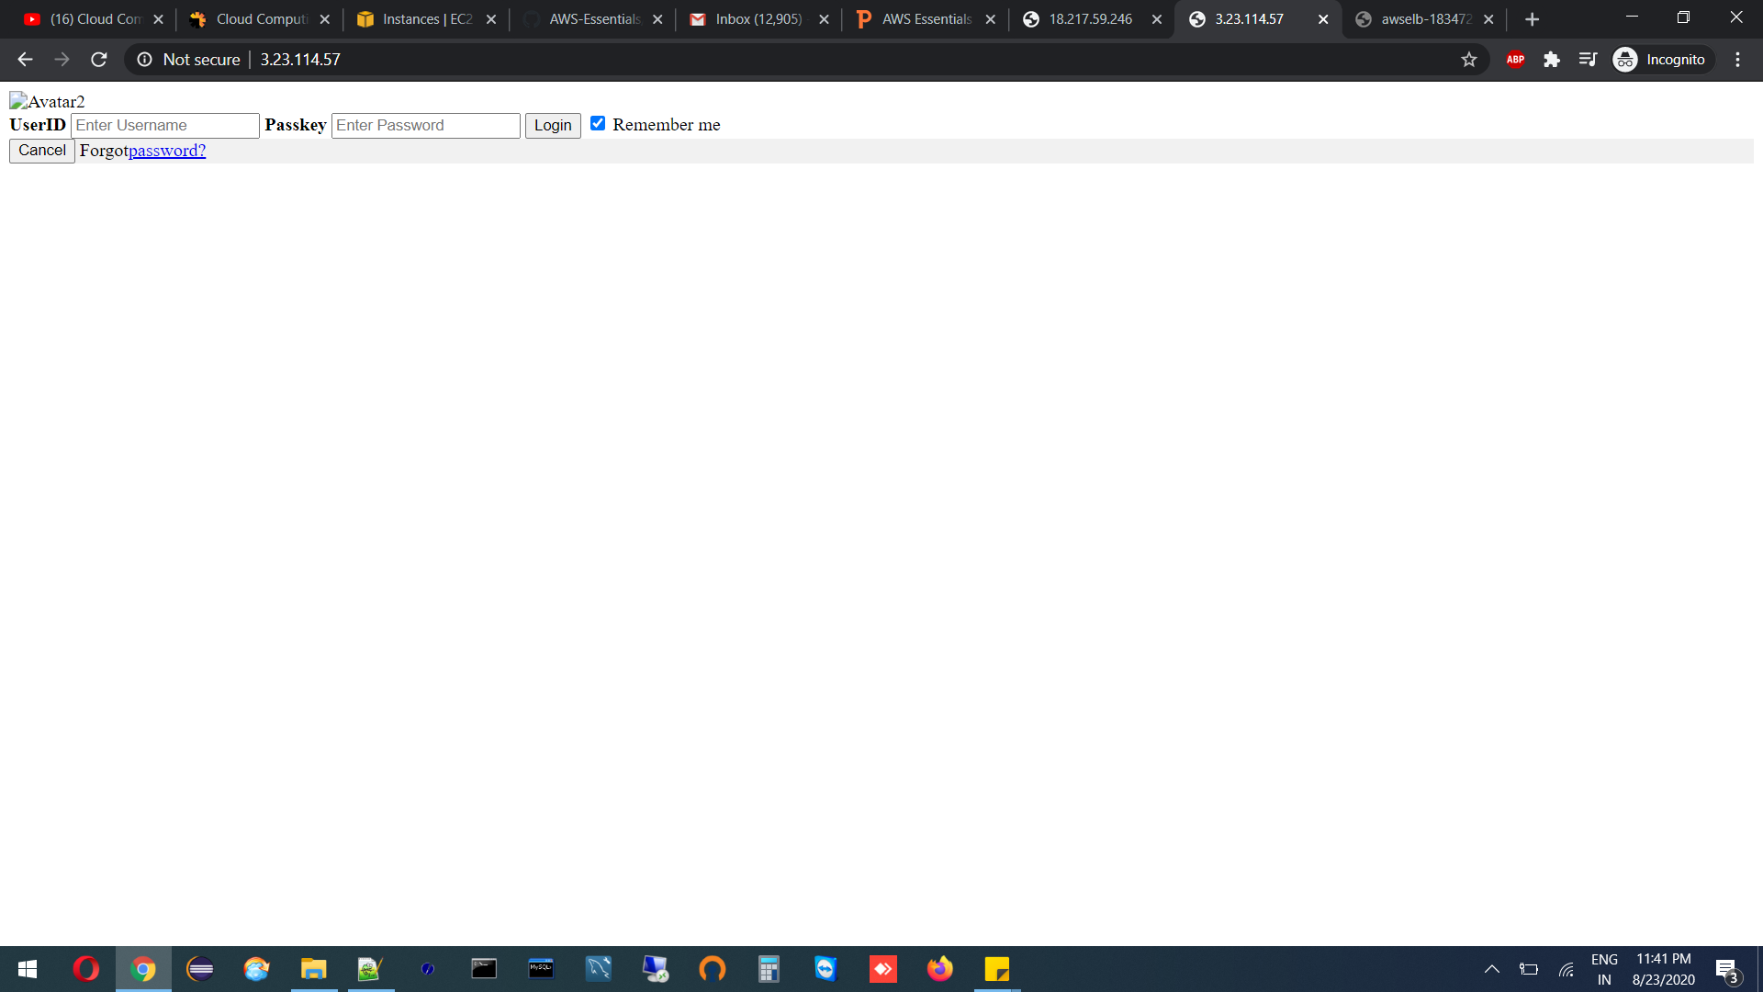

Slide 7
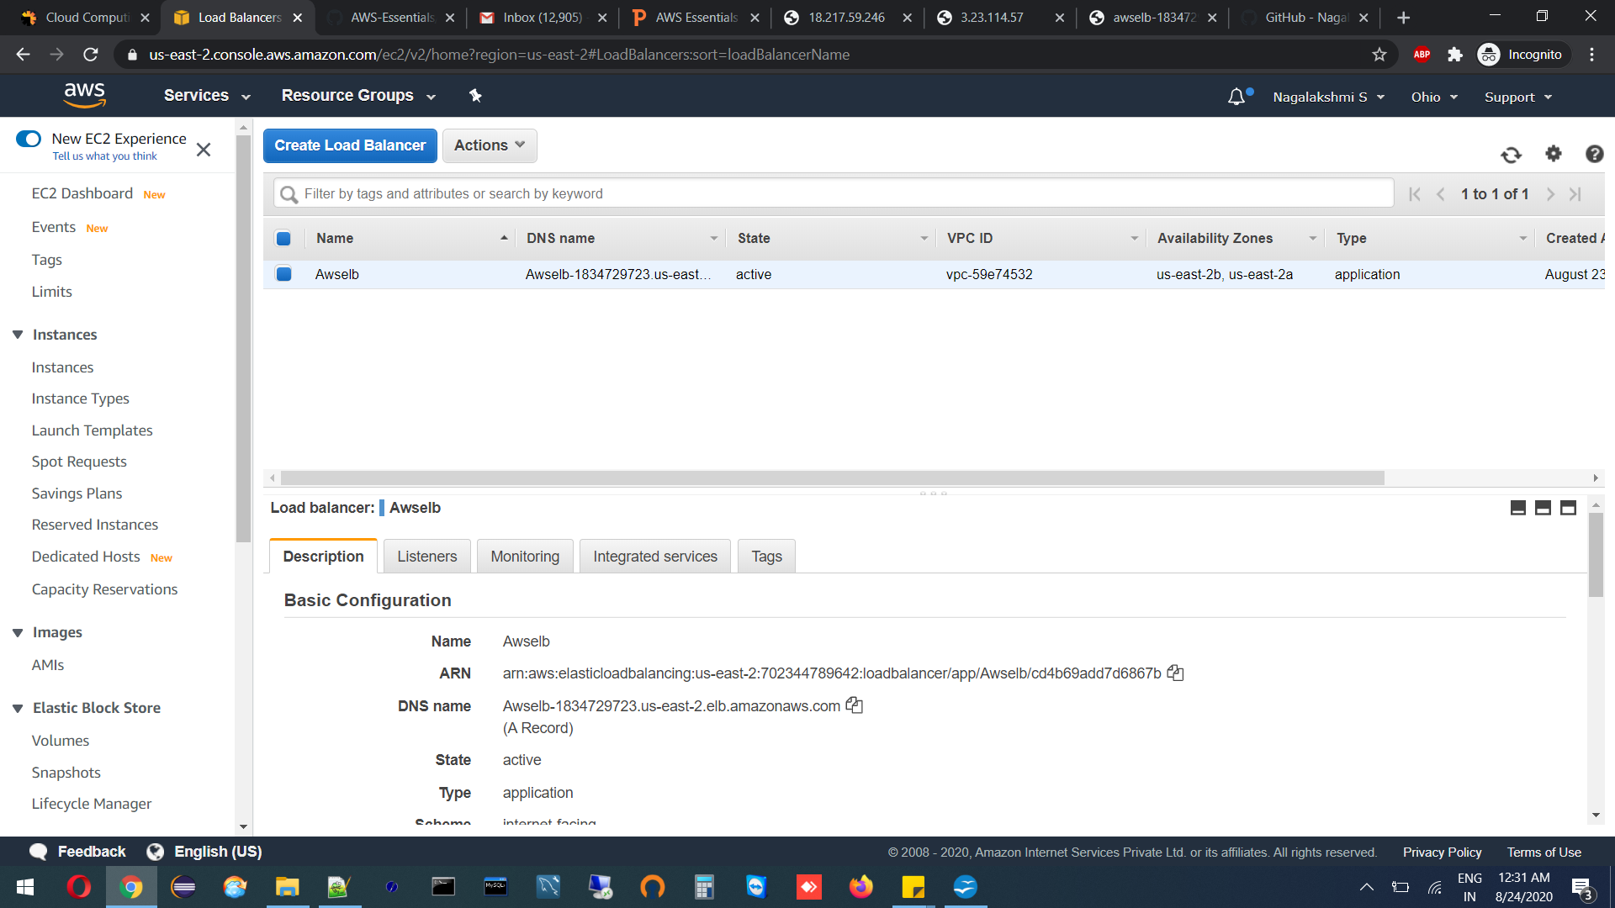
Creation Of Load Balancer

Slide 8
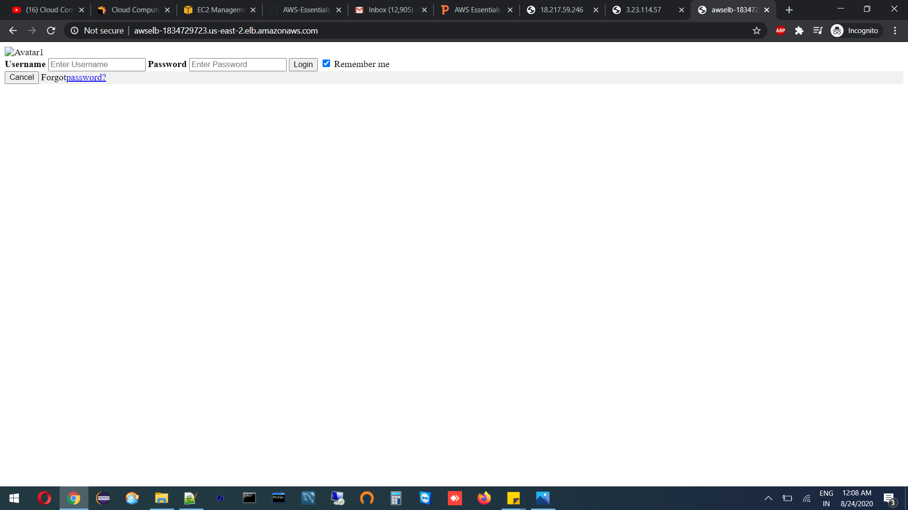
Functioning Of ELB

Slide 9
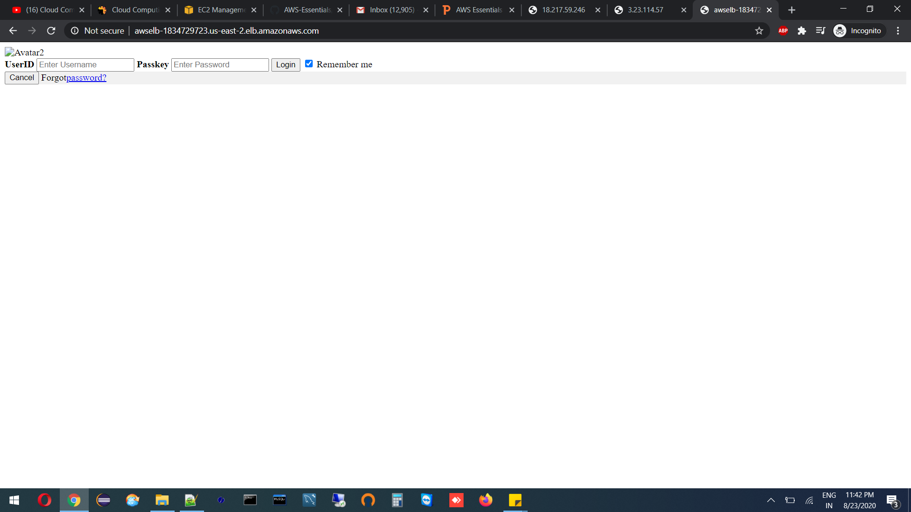

Slide 10
